Slide 1




Setting up a SIEM Environment using Wazuh
Setting up a SIEM Environment using Wazuh

Slide 2



Our Team
Ahmed Hatem Mahmoud
Abdullah Mahmoud Amin
Youssef Amr Elsayed Ahmed Mohamed Gamal Hussien Rahab Abdelazeem
logguardians@outlook.com

Slide 3
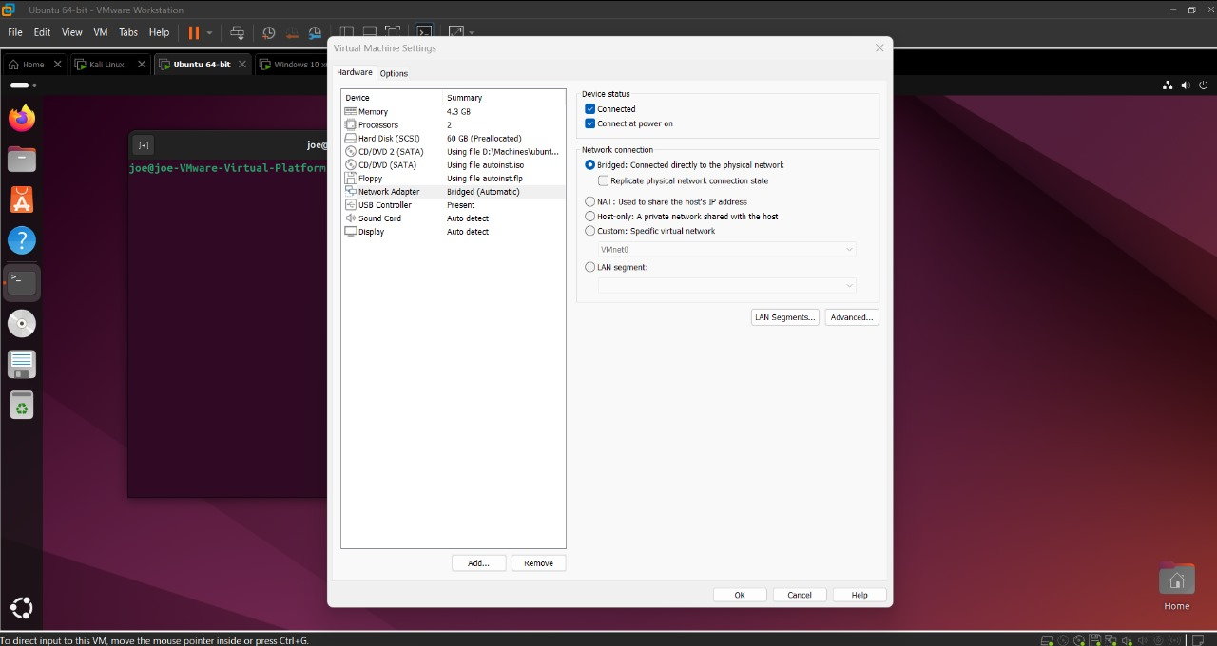

🔹 1. Network Configuration :
1-Both Ubuntu (Wazuh Server) and Windows (Agent) VMs were set to Bridge mode on VMware.
01

Slide 4
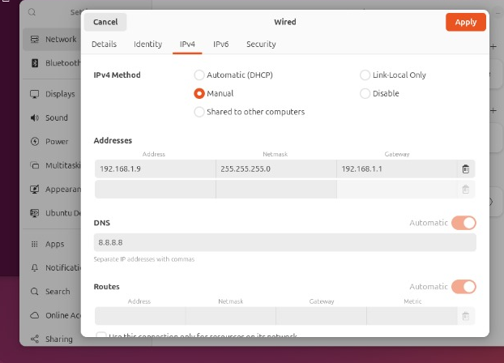
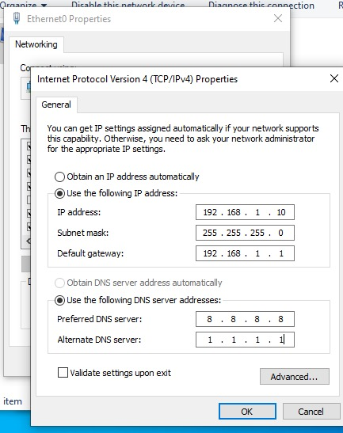
🔹 1. Network Configuration :
2-Static IPs were assigned :
Ubuntu: 192.168.1.9
Windows: 192.168.1.10
02

Slide 5
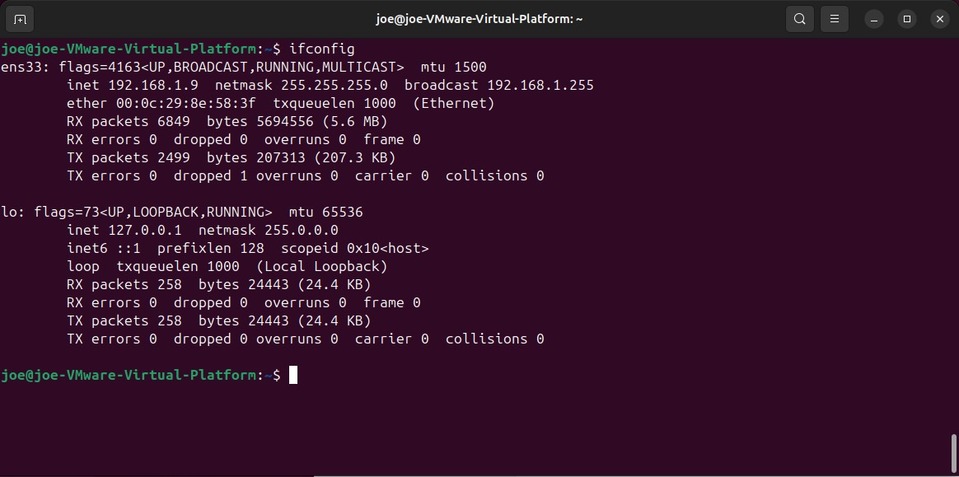
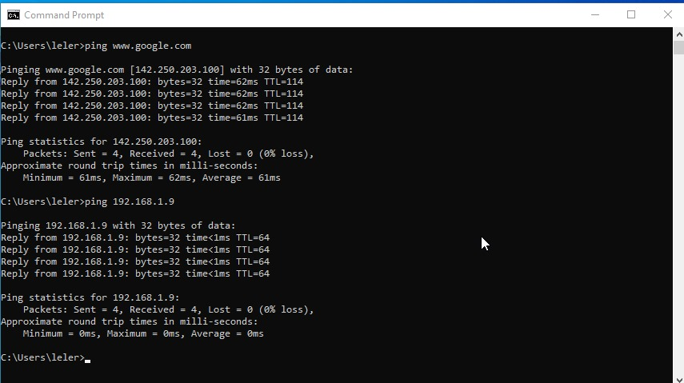
🔹 1. Network Configuration :
3-Network connectivity was verified using:
ifconfig on Ubuntu ✅
ipconfig on Windows ✅
Ping tests between the machines ✅
03

Slide 6
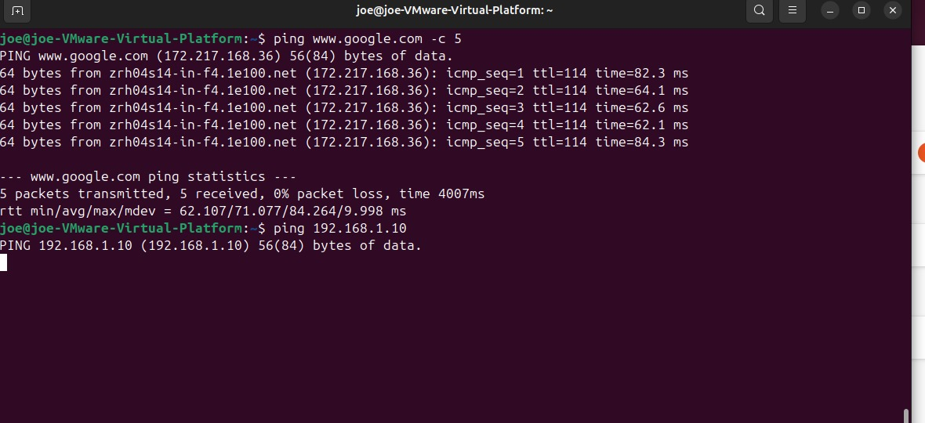
🔹 1. Network Configuration :
04

Slide 7
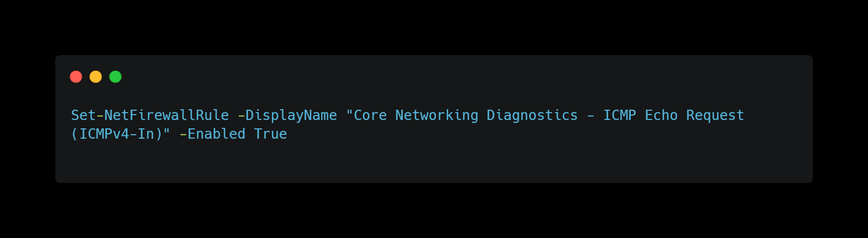
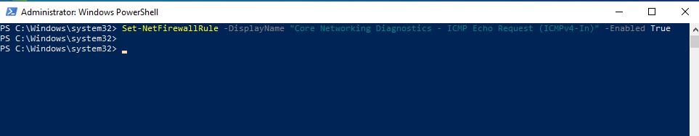
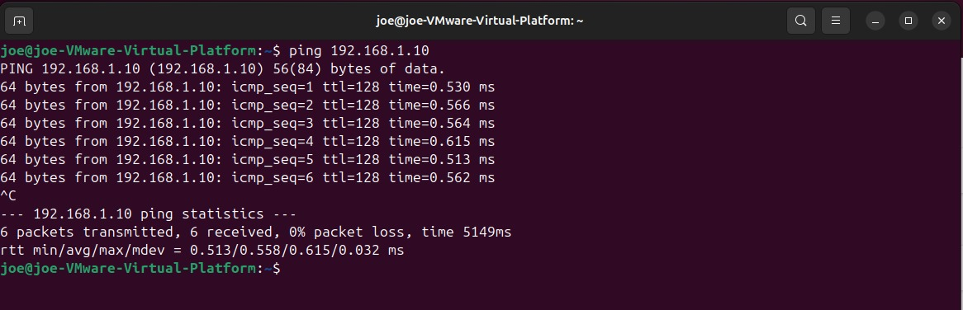
🔹 1. Network Configuration :
ICMP should be enabled on Windows via PowerShell:
05

Slide 8
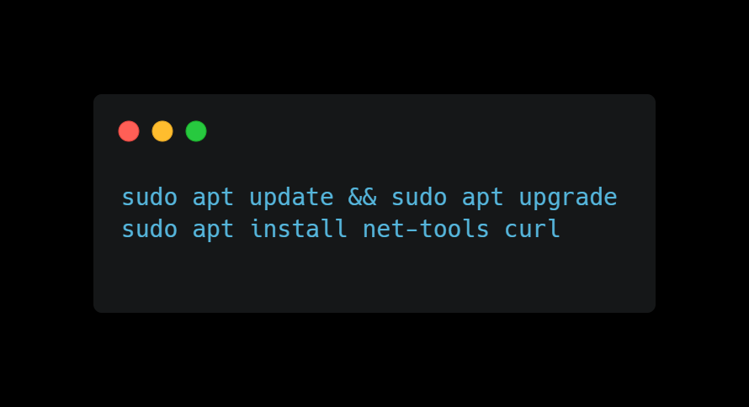
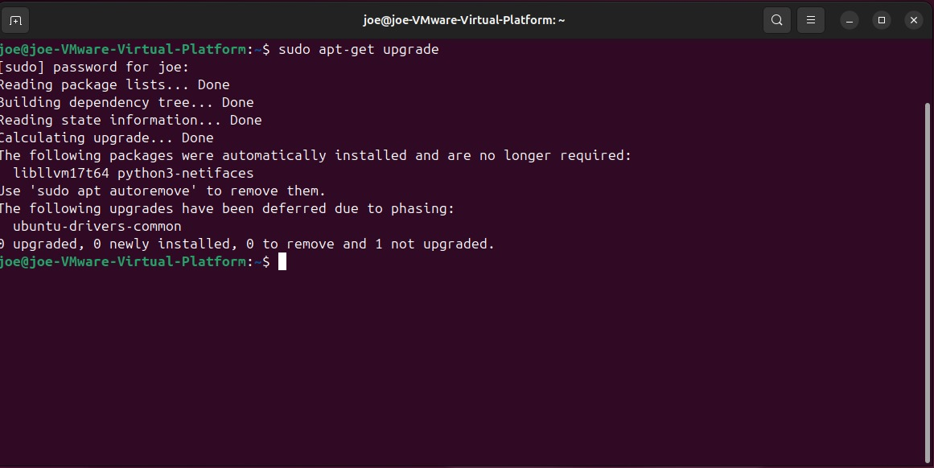
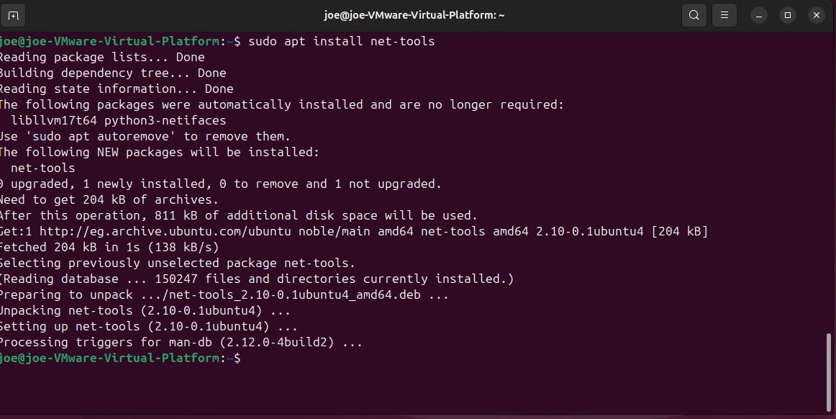
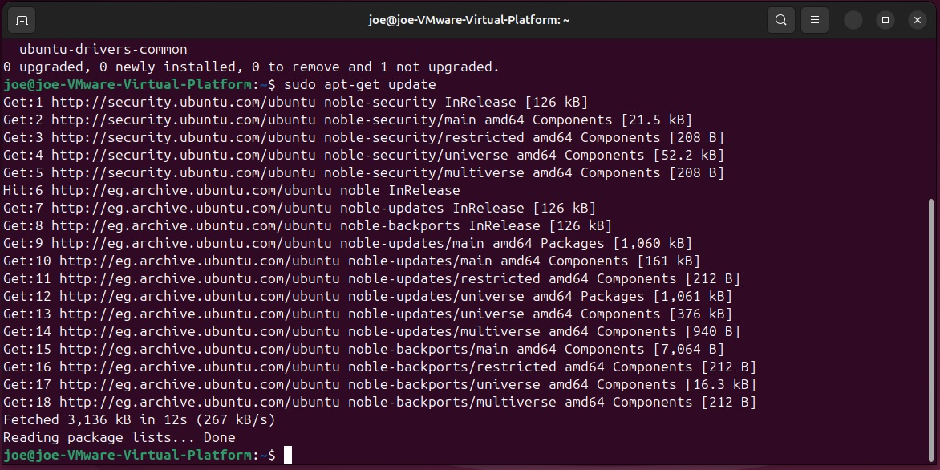
🔹 2. System Preparation (Ubuntu)
1-Updated the system:
06

Slide 9
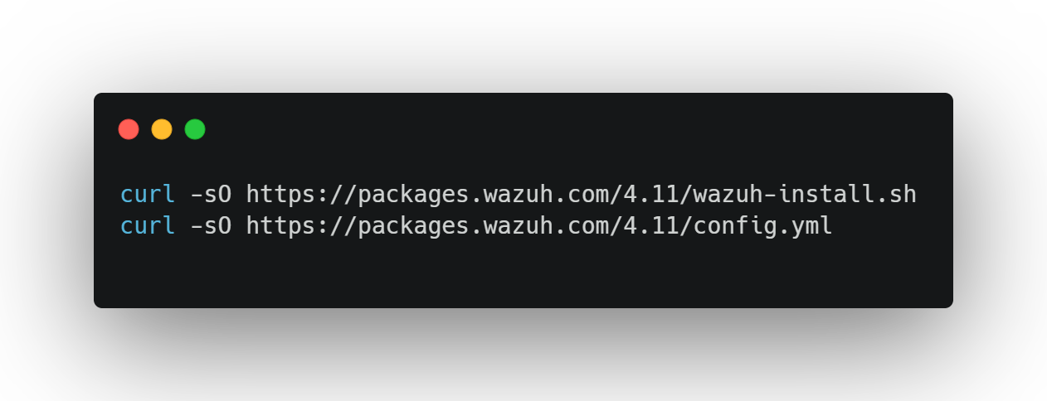
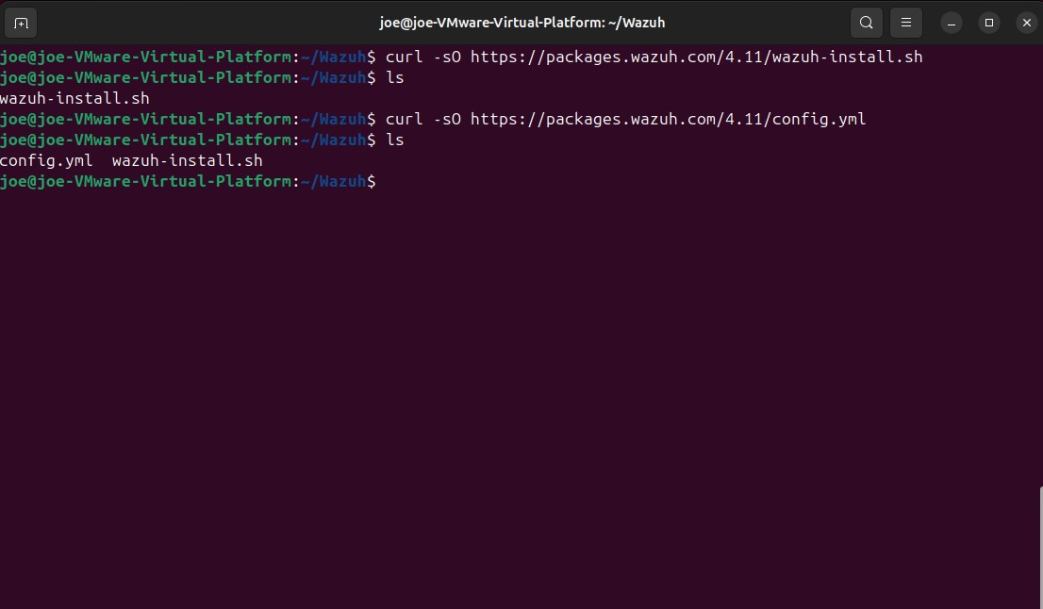
🔹 3. Wazuh Installation (Ubuntu)
1-Downloaded Wazuh installer and configuration:
07

Slide 10
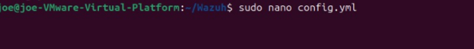
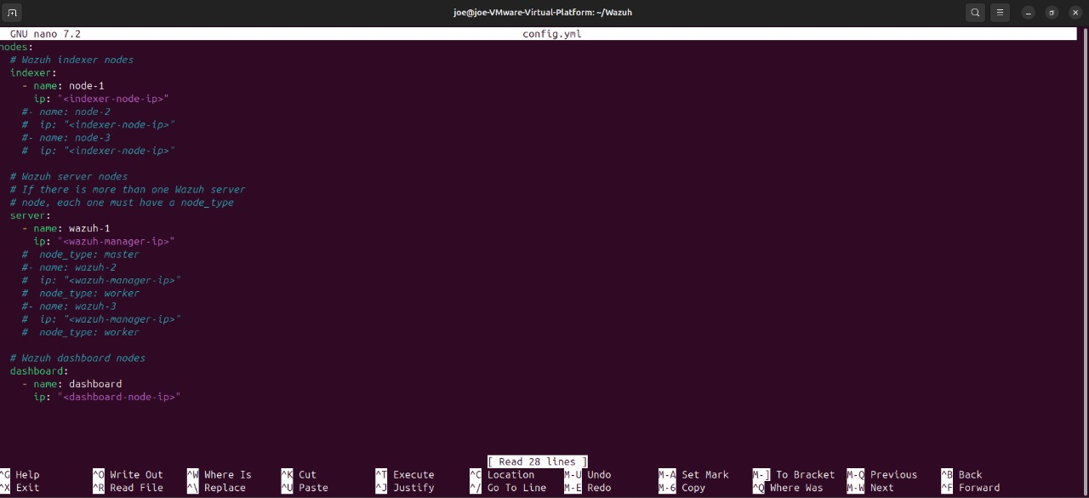
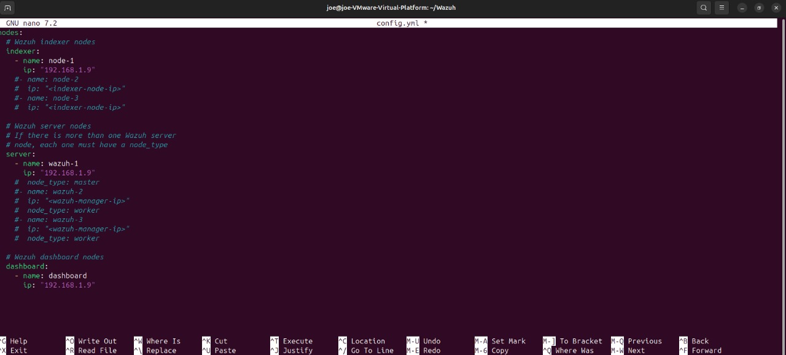
🔹 3. Wazuh Installation (Ubuntu)
2-Edited the config.yml and added Ubuntu machine IP under all nodes:
08

Slide 11
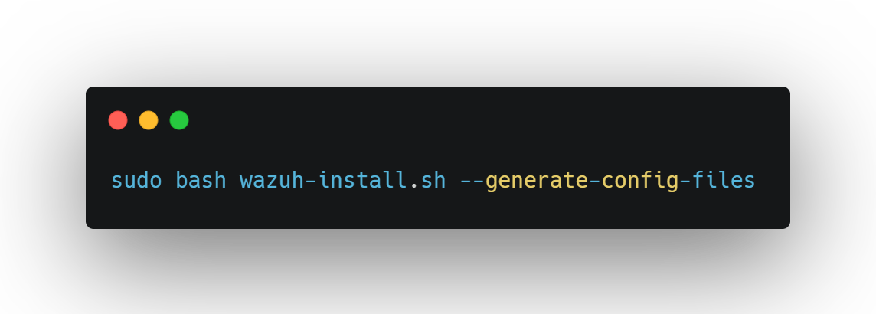
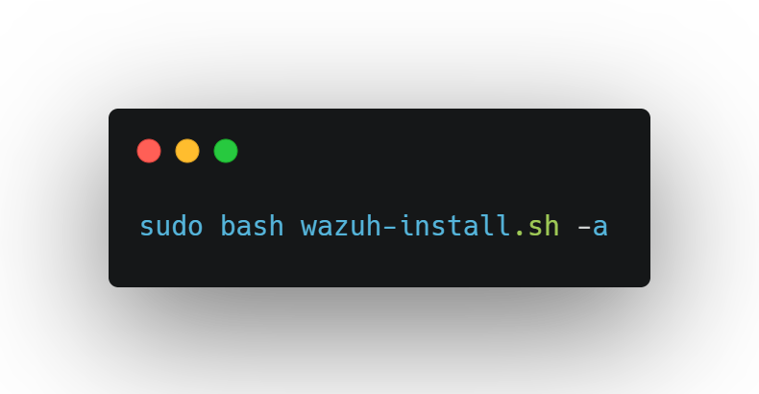
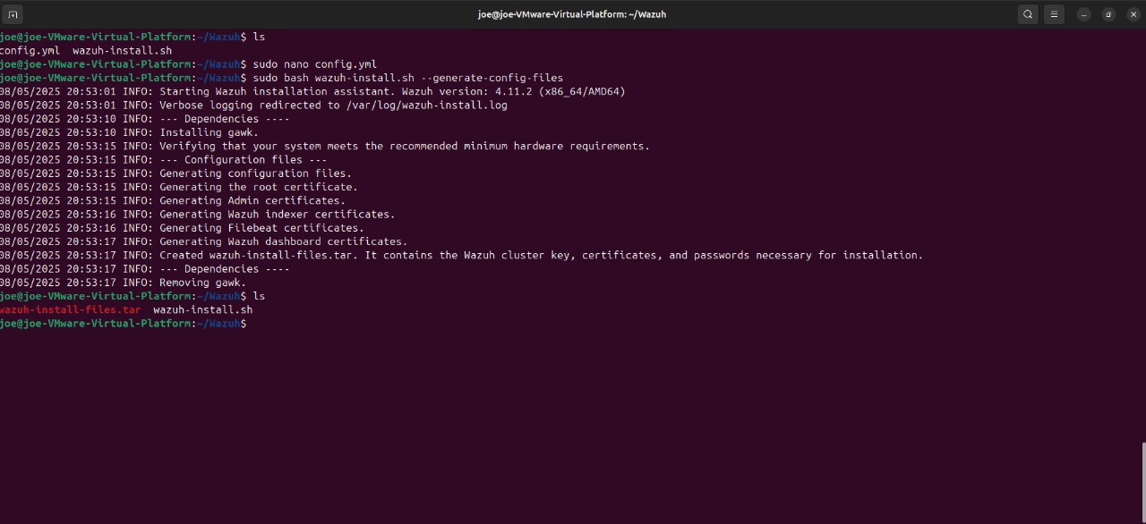
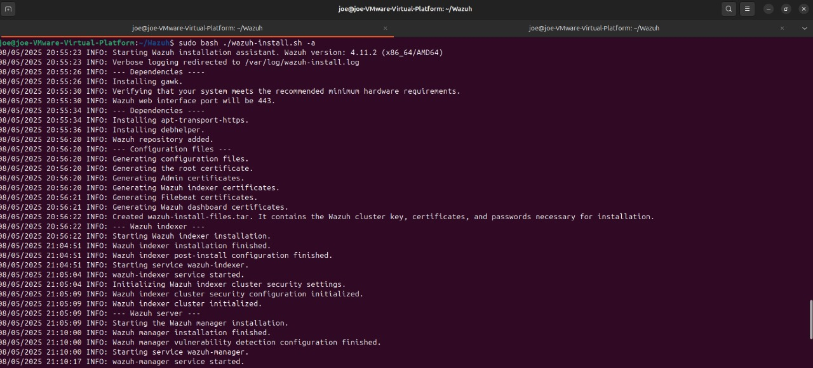
🔹 3. Wazuh Installation (Ubuntu)
3-Generated installation files:
09

Slide 12
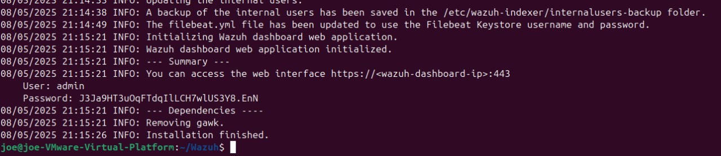
🔹 3. Wazuh Installation (Ubuntu)
3-Generated installation files:
10

Slide 13
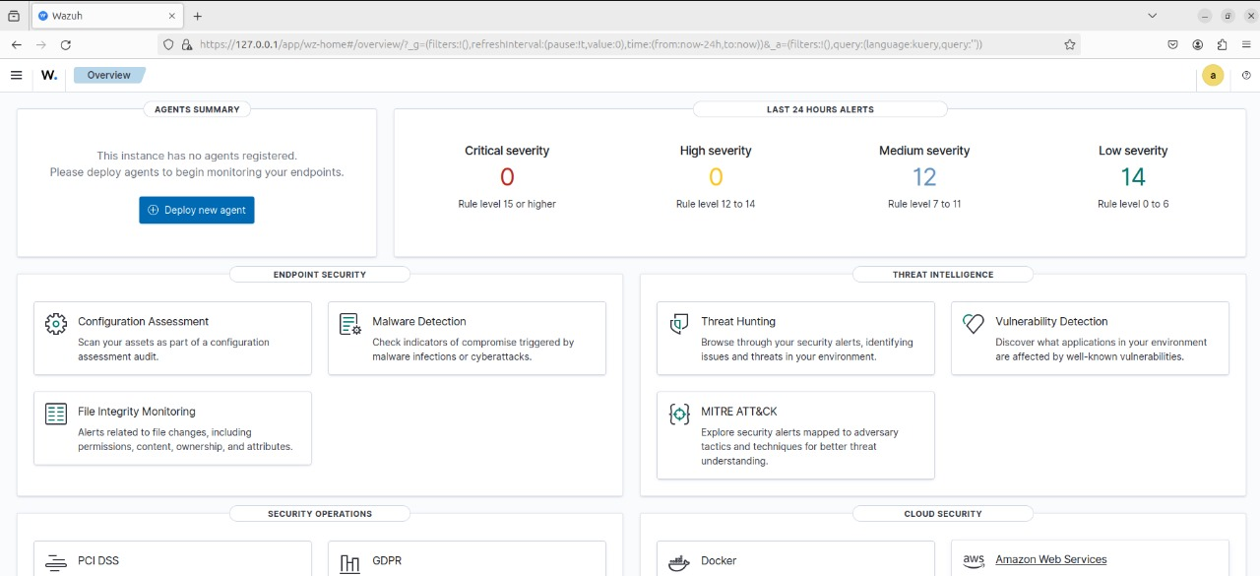
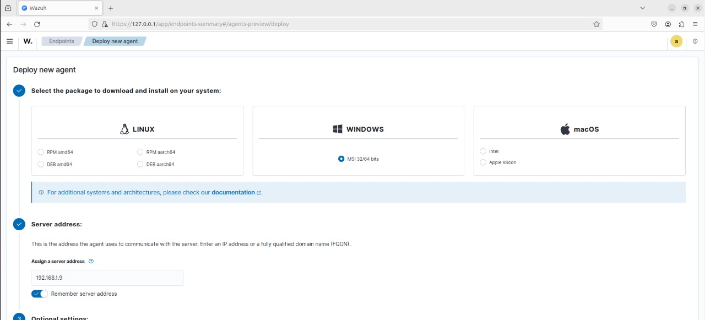
🔹 4. Wazuh Agent Deployment (Windows)
1-Deployed new agent from the Wazuh Dashboard.
Selected Windows → provided:
11

Slide 14
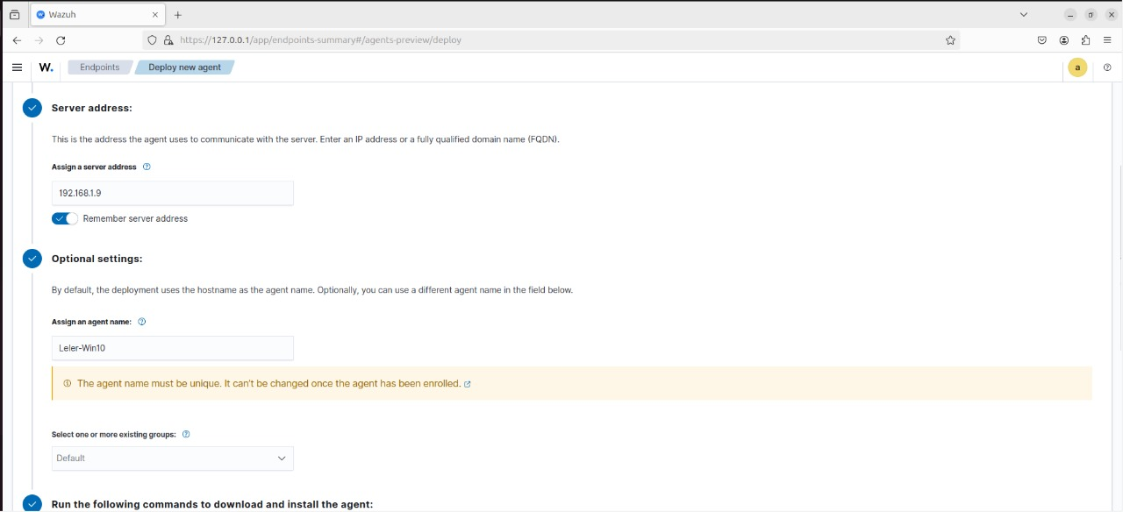
🔹 4. Wazuh Agent Deployment (Windows)
Server address: 192.168.1.9
Agent name
12

Slide 15
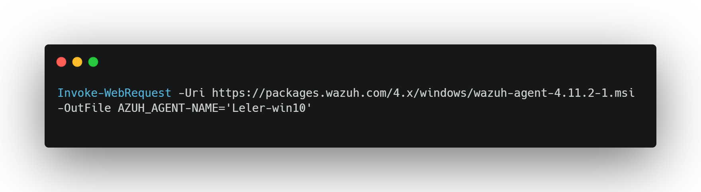
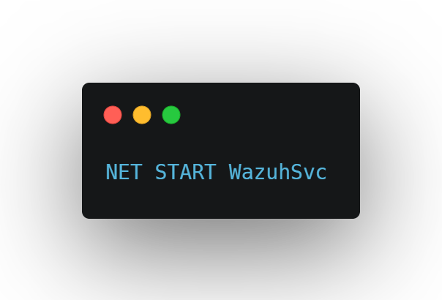
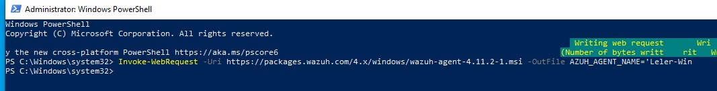
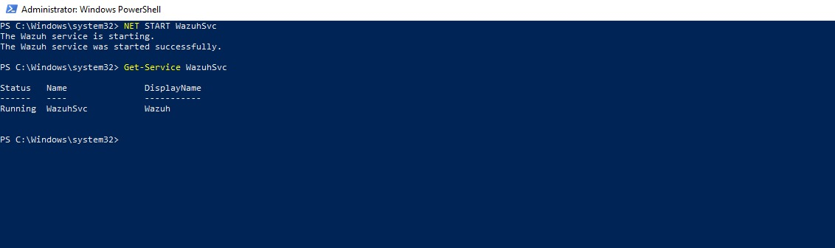
🔹 4. Wazuh Agent Deployment (Windows)
2-Downloaded agent using PowerShell:
3-Installed and started the service:
13

Slide 16
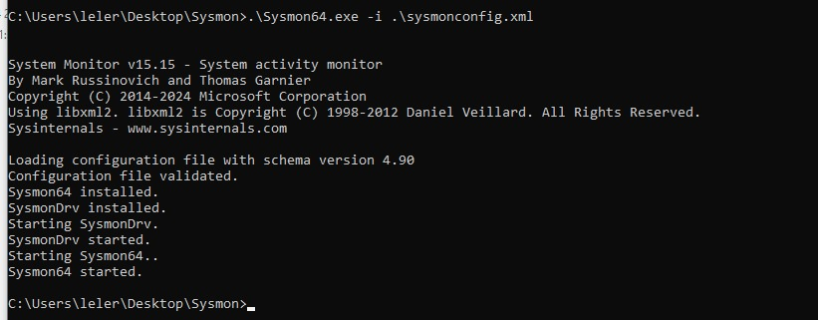
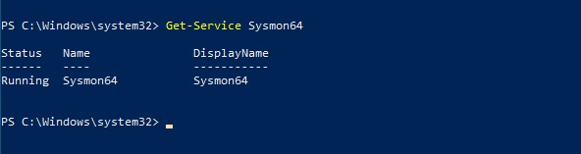
🔹 5. Sysmon Deployment and Integration
1:
Installed Sysmon v15.15 on Windows
Used sysmonconfig.xml for advanced event filtering
Validated config file successfully
Sysmon service started and began logging system events
13

Slide 17
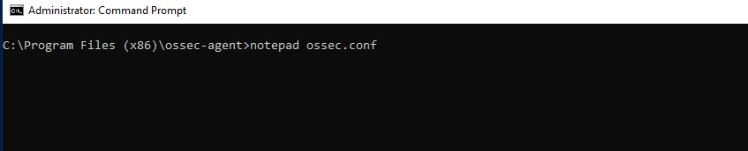
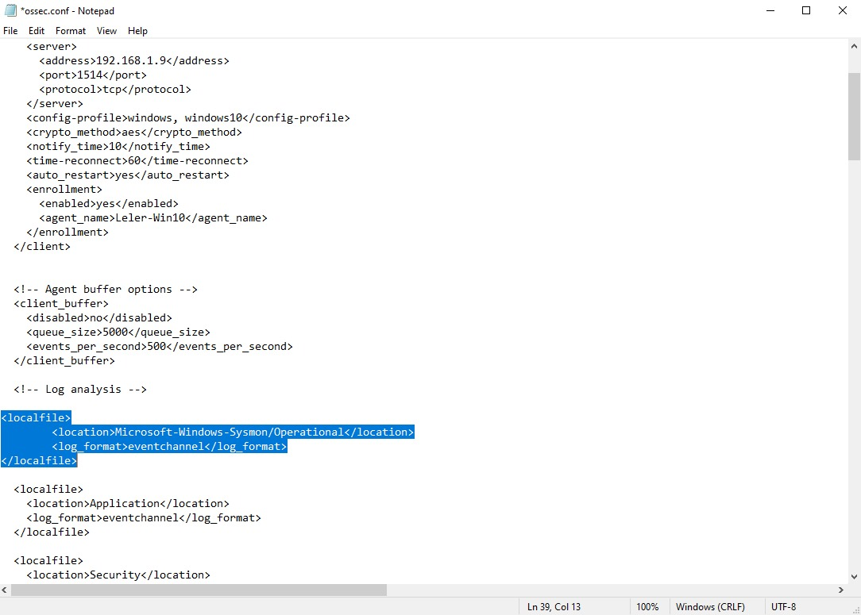
🔹 5. Sysmon Deployment and Integration
2- Edited ossec.conf to include Sysmon logs Log location added
13

Slide 18
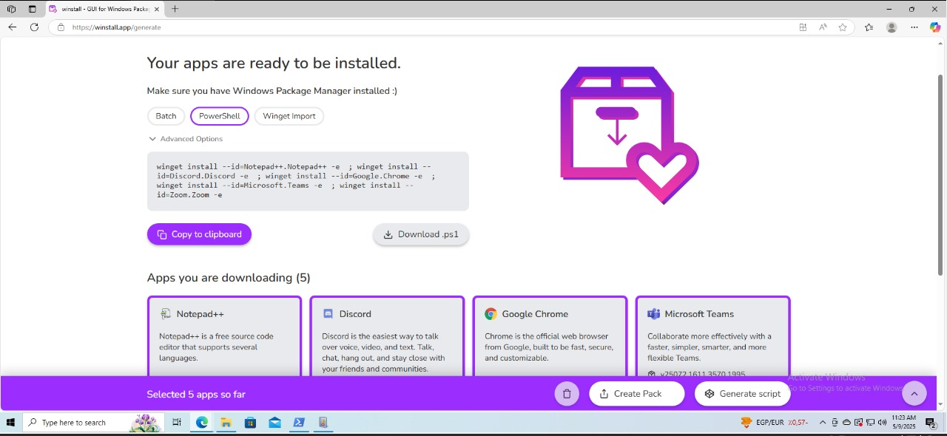
🔹 6. Testing and Noise Generation
1- Generated noise using PowerShell script (Winstall)Installed apps like:
Notepad++ Chrome Discord ZoomTeams
13

Slide 19
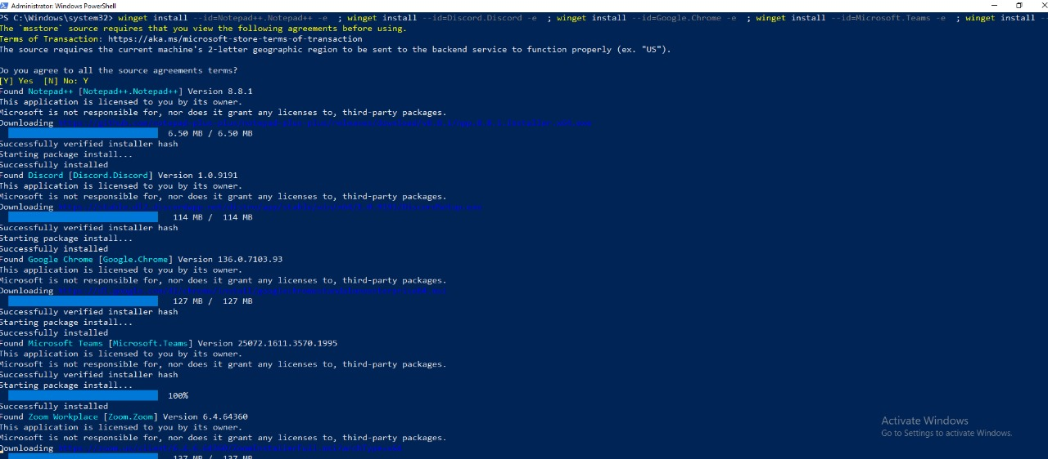
🔹 6. Testing and Noise Generation
2- by using the generated powershell script to download several apps using powershell, this should make a enough noise in Wazuh
13

Slide 20
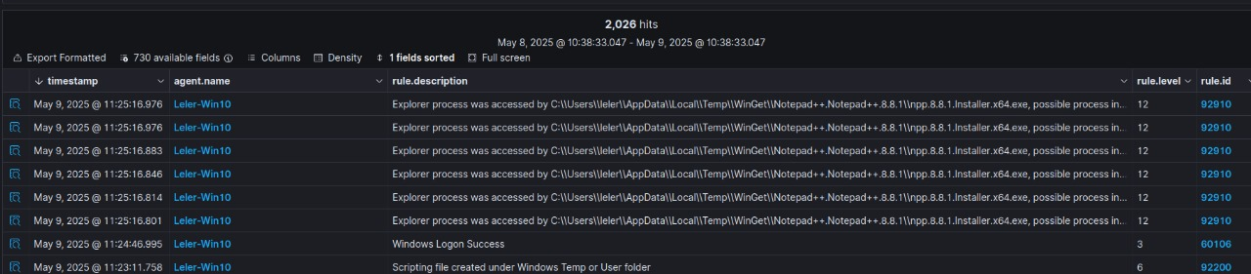
🔹 6. Testing and Noise Generation
3-Threat Hunting dashboard shows over 1000+ logon events.
13

Slide 21
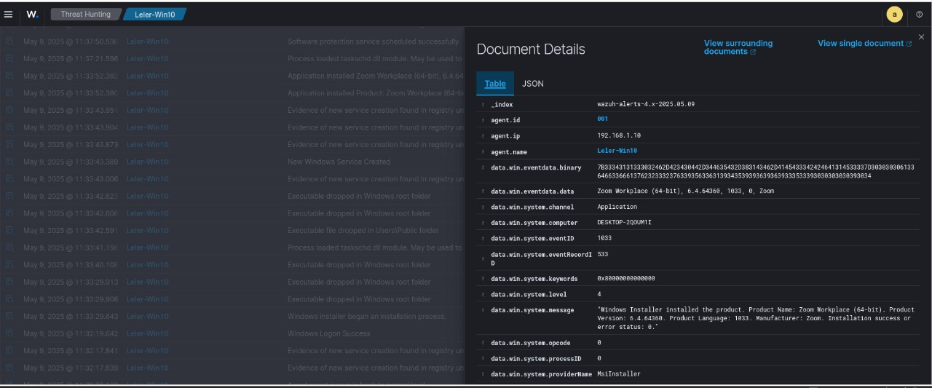
🔹 6. Testing and Noise Generation
13

Slide 22
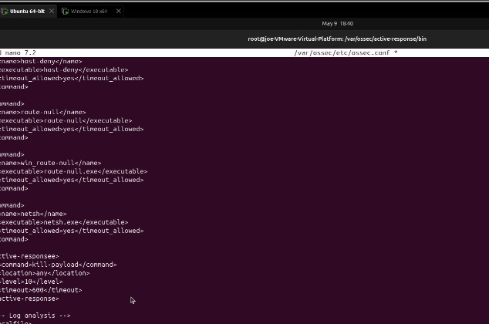
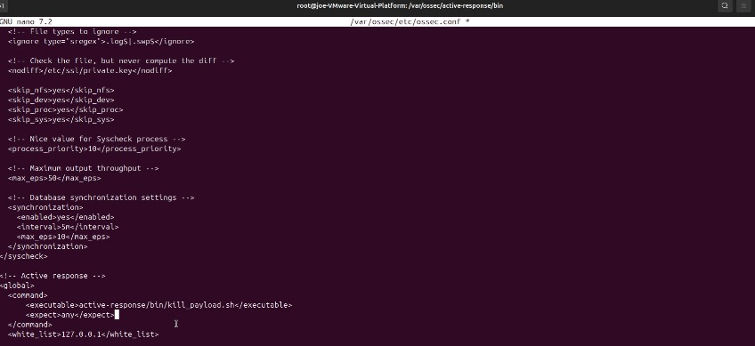
🔹 7. Active Response and Payload Simulation
1- Configured active response in Wazuh (Ubuntu)File: /var/ossec/etc/ossec.conf Script: kill_payload.sh
13

Slide 23
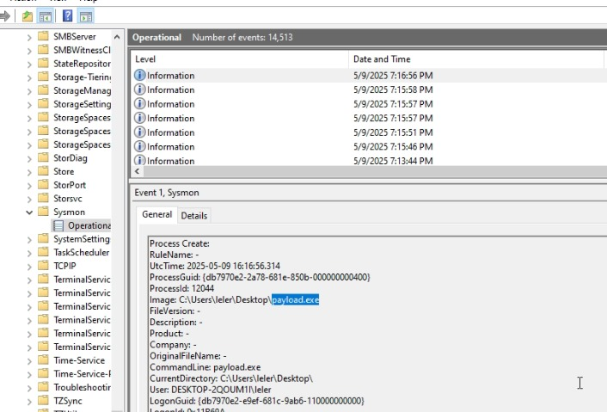
🔹 7. Active Response and Payload Simulation
2- Sysmon detected execution of payload.exe
13

